Slide 1
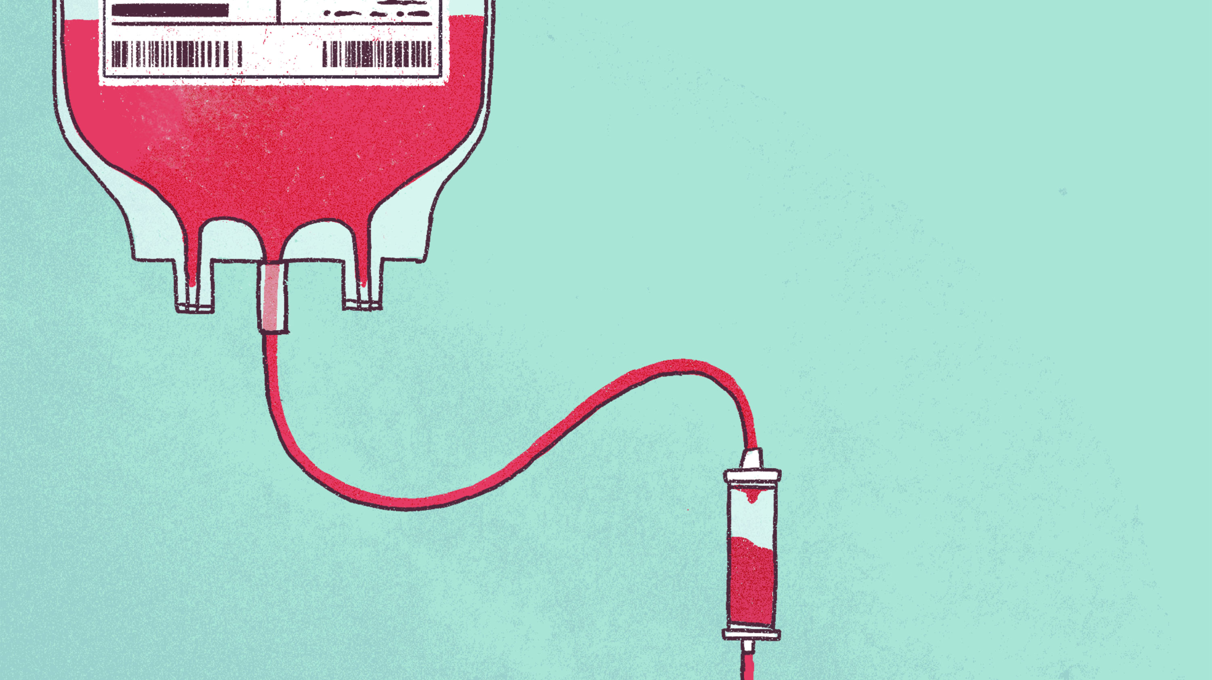
Make every drop count.
Single unit red cell transfusions should be the standard for non-bleeding, hospitalized patients.
Learn more about reducing inappropriate RBC transfusions at www.UsingBloodWisely.ca.

Slide 2
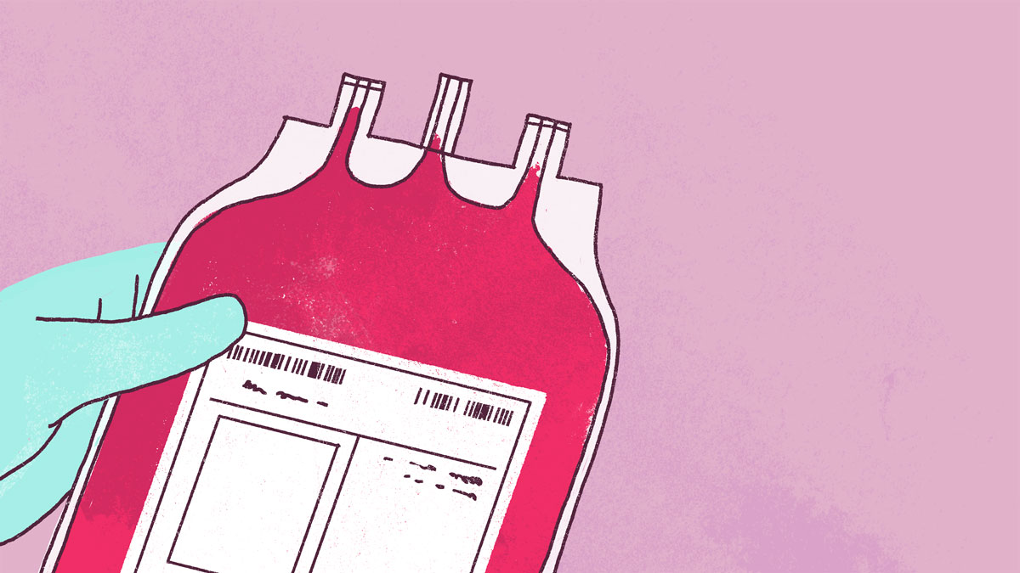
Why give two
when one will do?
Talk with your team about appropriate transfusion practices and make a positive impact on conserving Canada’s national blood supply.
Need help getting the conversation started? Visit: www.UsingBloodWisely.ca.

Slide 3
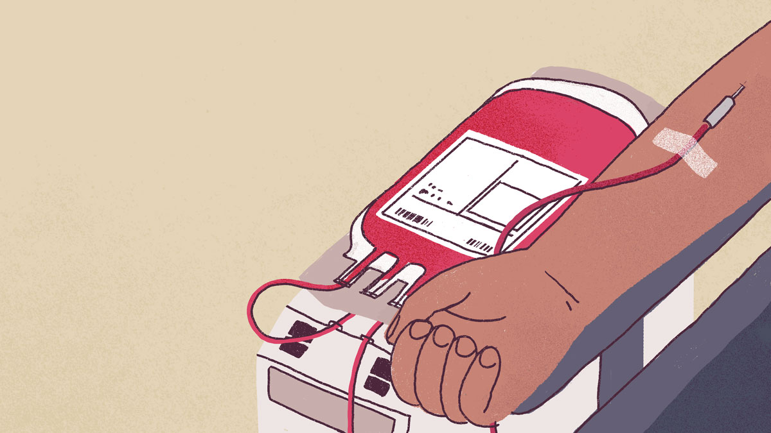
Sometimes, less is more.
Ensure safer and simpler options have been considered for blood management.
What are some alternatives to blood? Find out at: www.UsingBloodWisely.ca.

